Slide 1

Worker Profiling/RESEA Profiling Models

Slide 2
WPRS to RESEA
Enacted in 1993:
Worker Profiling and Reemployment Services (WPRS)
Public Law 103-152
Unemployment Compensation Amendments of 1993
Transition from REA to RESEA Began in 2015
Reemployment Eligibility Assessments and Reemployment Services (RESEA)

Slide 3
RESEA Program Goals
Get Claimants into the American Job Centers to receive:
UI Eligibility Assessments - ensure claimants meet initial and continuing UI eligibility requirements
Reemployment Services - assist these claimants in their search for and return to work
Profiling –used to identify claimants that are most likely to become long-term unemployed/to exhaust UI benefits and need assistance returning to work

Slide 4
RESEA
RESEA is designed to meet the needs of the targeted UI claimant population
Notes:
Important point.
In determining models and services – UI and American Job Center staff should work together
Characteristics of the targeted population should be reviewed
Different states will see different populations represented in their targeted populations

Slide 5
Initial WPRS Models
Initial Recommended/National Model Included:
Recall Status (screen)
Union Hiring Hall (screen)
Education
Job Tenure
Change in Employment – Previous Industry
Change in Employment – Previous Occupation
Local Unemployment Rate

Slide 6
Other Recommended Variables
Wage Replacement Rate
Delay in Filing for Benefits (days/weeks)
High Quarter Wage Rate
Number of Base Period Employers
Month of Year/Indicator for Season
Severance or Vacation Pay
More potential variables included in Tab 15

Slide 7
Profiling and State Operations
Coordinate between UI and Employment Services Providers
Balance Supply and Demand
Service capacity limited by:
Staff capacity
& Funding

Slide 8
Who gets Profiled?
New initial claimants that receive a first payment
RESEA provides services to ALL UCX claimants
UCX claimants do not need to be included in profiling.
RESEA still screens out:
Claimants on recall
Union Affiliated Claimants

Slide 9
Who Gets Referred?
Profiled Claimants assigned a probability of exhausting benefits (profiling score) (Pass/Fail in characteristic screen models)
Referral based on Supply (services) and Demand (claimants)
Profiled and Selected claimants arrayed by
Service office location
& Profiling score (from most likely to least likely to exhaust)

Slide 10
Who is Responsible?
UI responsible for notification of profiled claimants of:
Selection to program
Obligation to participate
Where and when to report
UI also notifies each service provider of selections and reporting instructions
Continuing UI eligibility is responsibility of UI

Slide 11
RESEA Services
Eligibility Assessments - including:
One-on-one UI eligibility reviews
Development of Individual Reemployment Plans
Orientation to American Job Centers
Relevant Labor Market Information
Referral to appropriate services
Reemployment Services - including but not limited to:
Assessment of skills
Counseling regarding reemployment approaches
Job search assistance and placement services
Job search workshops and referrals
Notes:
Resume writing workshops, etc…

Slide 12
Profiling Models
Models should be updated on a regular basis
Every 1 to 3 years → update coefficients
Every 3 to 5 years → new model
Review of RESEA referrals should be ongoing
Open dialogue between UI and AJC
Continuous monitoring of referred populations
Continuous monitoring of state’s economic climate and UI population for significant changes

Slide 13
Other Notes
Characteristic Screen Models:
Provide identical Profiling Scores (likelihood of exhaustion) to groups of claimants.
Referral for services assigned using random number generator.
Additional Profiled claimants can remain in “selection pool” for several subsequent weeks.
Referral of these claimants will be based on relative Profiling Scores compared to newly profiled claimants.

Slide 14
Important Recent Information on RESEA
UIPL No. 7-16
FY 2016 UI Reemployment Services and Eligibility Assessment Grants
http://wdr.doleta.gov/directives/corr_doc.cfm?DOCN=6312
UIPL No. 13-15 and 13-15 Change 1
FY 2015 UI RESEA Grantsand FY 15 RESEA Grants Q & A’s
http://wdr.doleta.gov/directives/corr_doc.cfm?DOCN=4482
http://wdr.doleta.gov/directives/corr_doc.cfm?DOCN=3631
Notes:
UIPL 7-16 includes a section on the required reports detailing some basic information on reviewing the state’s 9128 and 9129 data.

Slide 15
Recent Research
State Profiling Model Summary - 2014
Scott Powell – John J. Heldrich Center for Workforce Development
WPRS Evaluation of State Worker Profiling Models - 2007
Coffey Communications
Study of UI Exhaustees – Ongoing
Impact of the REA Initiative – 2011
Impact of the REA Initiative in Nevada – 2012
Notes:
These items and more are referenced more thoroughly in the additional resources section of the binder.

Slide 16
Use of Stats Software for Modeling
We use SPSS in the seminar due to simple, menu driven Graphical User Interface
Licenses of SPSS are not cheap and most similar alternatives are as expensive or more expensive
Consider using R https://www.r-project.org/

Slide 17
Using R
We recommend using R Studio for a simple, well laid out User Interface
R uses the R programming language
Packages including everything from Graphics capabilities to Logistic Regression Modeling to CHAID analysis are available for free
Updates are regularly released for R and for many of the available packages
FREE!!!! & Powerful!

Slide 18
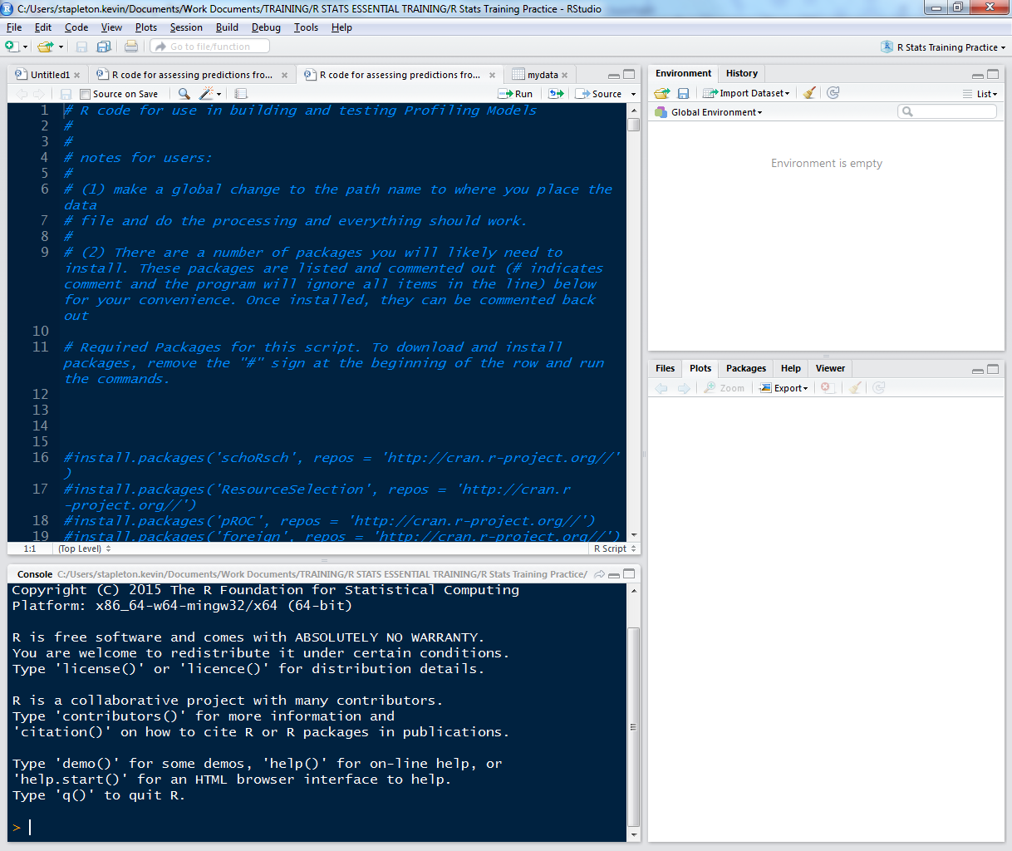
The R User Interface

Slide 19
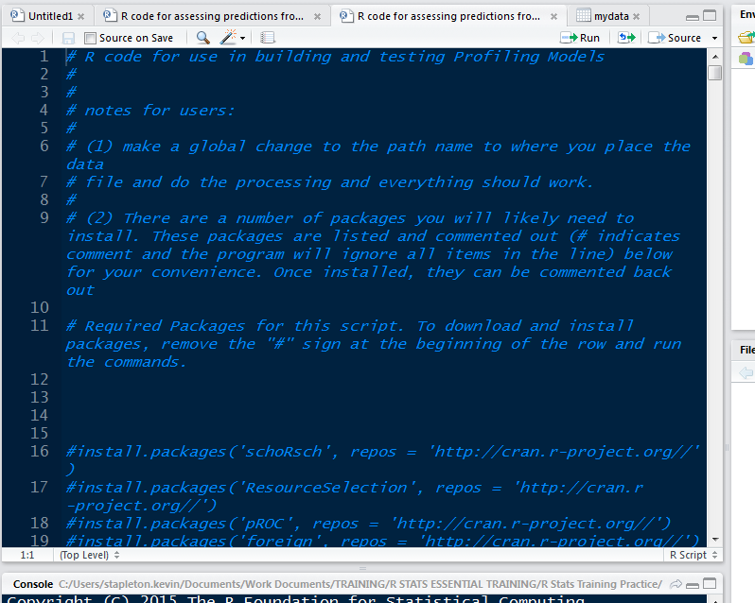

Slide 20
Using R
Install desired packages found at: https://cran.r-project.org/
install.packages('foreign', repos = 'http://cran.r-project.org//')
Load (activate) required packages
library("foreign")
Reference http://stackoverflow.com/ and thousands of other R help/guide sites across the web.

Slide 21
Using R
Base script to include:
All packages required
Data retrieval and basic formatting
Overall summary/review of dataset
Sample analytical calculations and comparisons
Descriptive and Frequency Calcs and Crosstabs
Sample categorizations and other relevant basic calculations
Logistic Regression function
Hosmer Lemeshow Test
ROC Curve Production
Decile analysis

Slide 22
Wide Availability of Additional Functions Through FREE Packages
Advanced graphics capabilities (ggplot2 package)
CHAID Analysis (CHAID package)
Other advanced modeling techniques such as neural nets, machine learning, etc…

Slide 23
A Step-By-Step Approach to Model Building
What to Expect from this Seminar?

Slide 24
Steps to Building a Profiling Model
Step 1: Select Data
Step 2: Review and Prepare Dataset for Use
Step 3: Analyze potential variables and relationships Step 4: Build Logistic Regression Model (Using a Stepwise Process)
Step 5: Model Evaluation and Validation
Step 6: Ongoing Evaluation of Model Performance and Updating/Rebuilding Model

